Slide 1


3D Graphics & Animation
Workshop 3

Slide 2

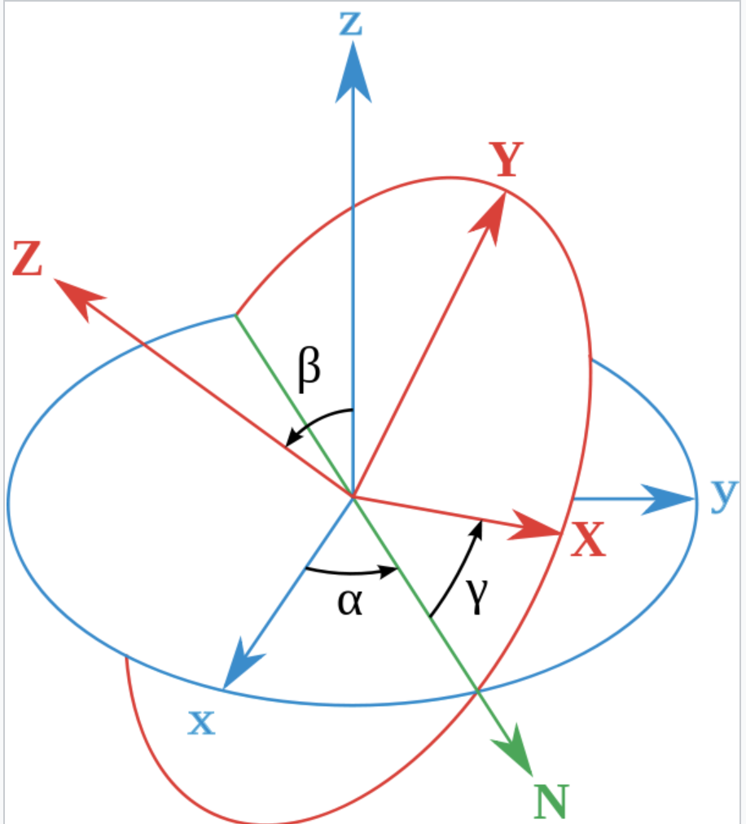
Transformation
The three basic transformation are:
Translate
Move the object to a new location
Rotate
Rotate the object using x, y or z axis (Euler angles)
https://docs.unity3d.com/ScriptReference/Transform.Rotate.html
https://docs.unity3d.com/Manual/QuaternionAndEulerRotationsInUnity.html
Scale
Make the object larger or smaller

Slide 3
Transformation
Rotation in Euler angles is easy for human mind to understand.
However it has one issue, Gimbal lock
Gimbal lock is the loss of one degree of freedom in a three-dimensional, three-gimbal mechanism that occurs when the axes of two of the three gimbals are driven into a parallel configuration, "locking" the system into rotation in a degenerate two-dimensional space.
https://en.wikipedia.org/wiki/Gimbal_lock
Watch this video for more
https://www.youtube.com/watch?v=zc8b2Jo7mno

Slide 4
Transformation
To avoid Gimbal lock, one alternative solution is to use quaternions (4D number)
Watch this videos for more
https://www.youtube.com/watch?v=d4EgbgTm0Bg
https://www.youtube.com/watch?v=1yoFjjJRnLY

Slide 5
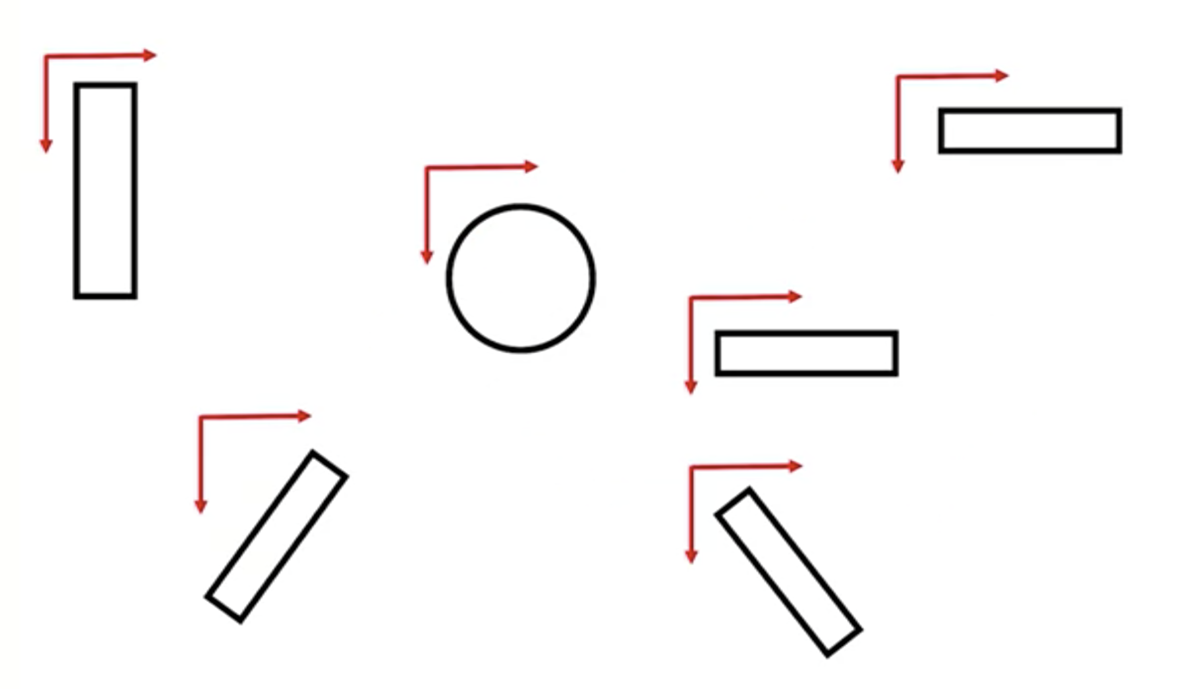
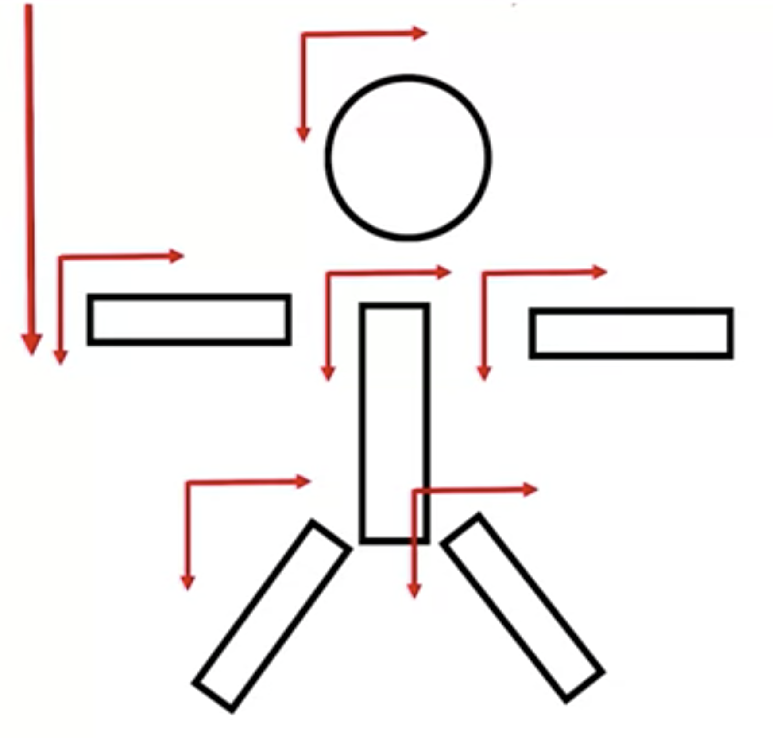
Compound object
Individual object each has their own coordinate system, each can transform on their own.
Many objects can be compounded and has share a coordinate system so that they are transform together.

Slide 6
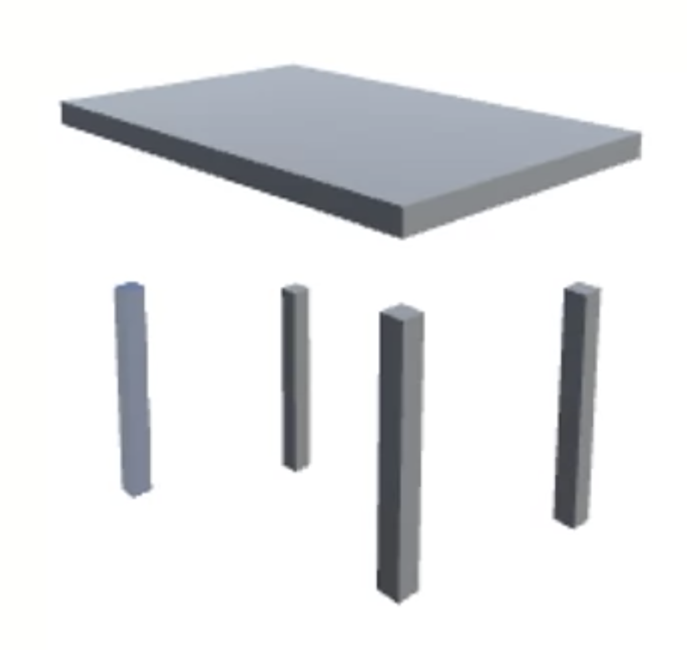
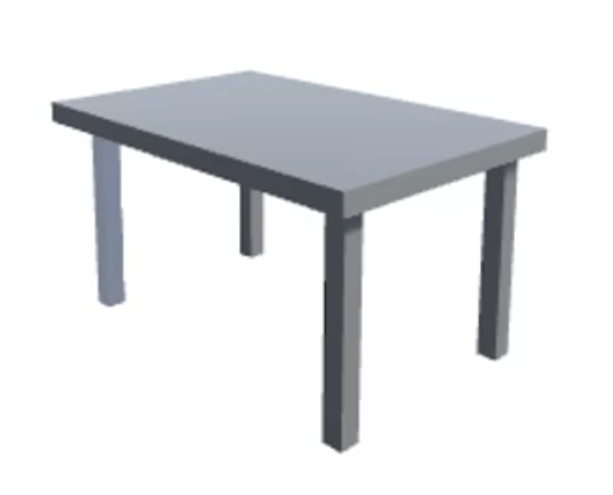
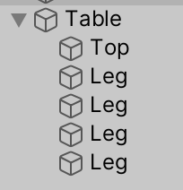
Compound object
Lab practice
Create 5 cubes to form a table.
Put all the 5 cubes under an Empty Object and name it table.
Try to do different transformation on the table.

Slide 7

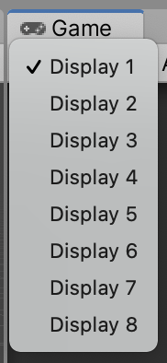
Camera
Each scene need at least one camera.
Multiple's camera can be created in one scene.
A camera has a Target Display that can be set to Display 1 to 8.
In the game scene, we can select which display to use

Slide 8
Camera
Lab practice
Add in a new new camera in the table scene.
Place the camera on the table.
Set the Target display of the new camera to Display 2.
Test out the game scene with Display 1 and Display 2.

Slide 9
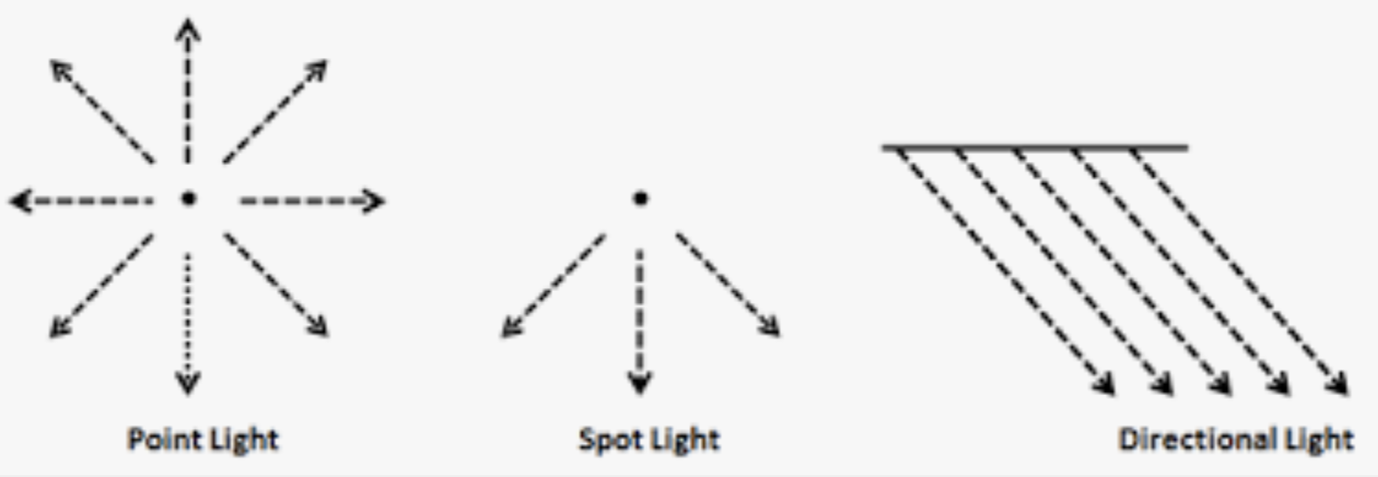
Light
By default, lights in Unity - directional, spot and point, are realtime.
This means that they contribute direct light to the scene and update every frame. As lights and GameObjects are moved within the scene, lighting will be updated immediately.

Slide 10
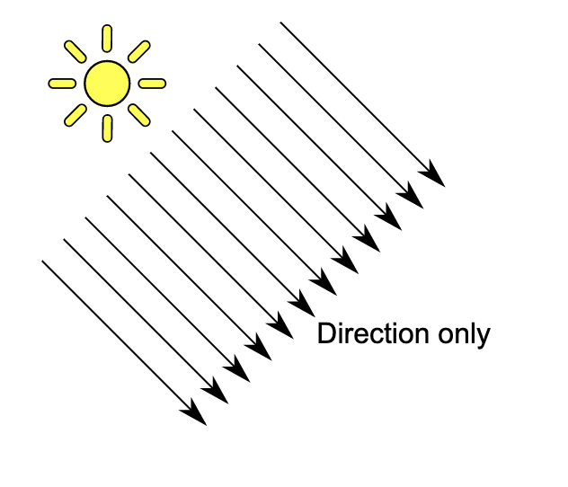
Light
Directional light
Default lighting in Unity3D scene
Similar to ”sun”, the light is shone from far away.
Only affected by rotation

Slide 11
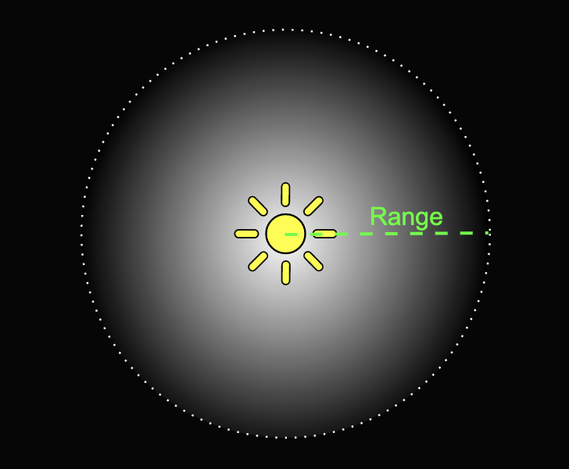
Light
Point light
located at a point in space
sends light out in all directions equally.
direction of light hitting a surface is the line from the point of contact back to the center of the light object.
intensity diminishes with distance from the light, reaching zero at a specified range
useful for simulating lamps and other local sources of light in a scene.
only affected by translation

Slide 12
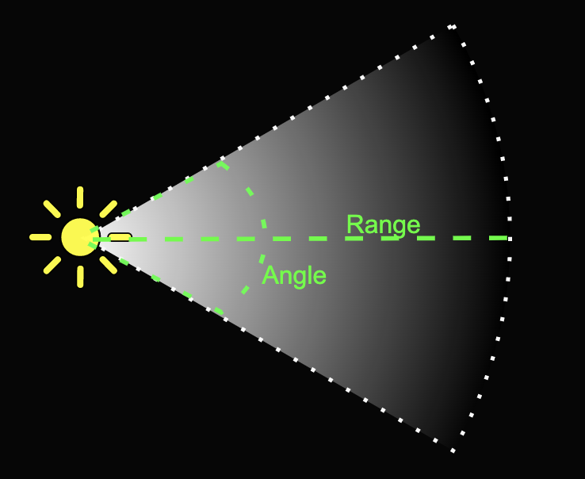
Light
Spot light
However, the spot light is constrained to an angle, resulting in a cone-shaped region of illumination.
The center of the cone points in the forward (Z) direction of the light object.
Light also diminishes at the edges of the spot light’s cone.
Widening the angle increases the width of the cone and with it increases the size of this fade.
Affected by translation and spots angle.

Slide 13
Light
Lab practice
In the previous table scene, add in point and spot light.
Adjust the point light
Position, Range, Intensity
Adjust the spot light
Position, Range, Spot angle, Intensity

Slide 14
Light
Area (baked only)
A Light that is defined by a rectangle/disc in the Scene
Emits light all directions uniformly across its surface area but only from one side of the rectangle/disc.
Lighting calculation is quite processor-intensive,
Not available at runtime and can only be baked into lightmaps (texture)
Used to illuminate objects that are not moving (static)
E.g. ground, walls, building
Effect of lights are pre-computed for static objects to produce lightmaps. The lightmaps (tecture)are then overlaid on the static objects.

Slide 15
Light
Lab practice
In the previous table scene, add in an area light.
Set all the objects to static.
Note: Lightmap will only be generated on static objects
Set the intensity to 50 and colour to green.
Go to Window=>Rending=>Lighting
Wait a while for Unity to generate the lightmap.
Test the game scene

Slide 16
Light
Area (baked only)
Baking lights is usually done at the last steps
It is done to increase the performance by reducing number of unnecessary lighting calculation on each frame at run time.
Unity does not modify the original textures, it just overlay the generated lightmap on the objects.

Slide 17
Prefabs
Unity’s Prefab system allows you to create, configure, and store a GameObject complete with all its components, property values, and child GameObjects as a reusable Asset.
The Prefab Asset acts as a template from which you can create new Prefab instances in the Scene.
https://docs.unity3d.com/Manual/Prefabs.html

Slide 18
Prefabs
Lab practice
Make the table that you have created into a prefab asset.
Create many tables in the scene using the prefab.

Slide 19
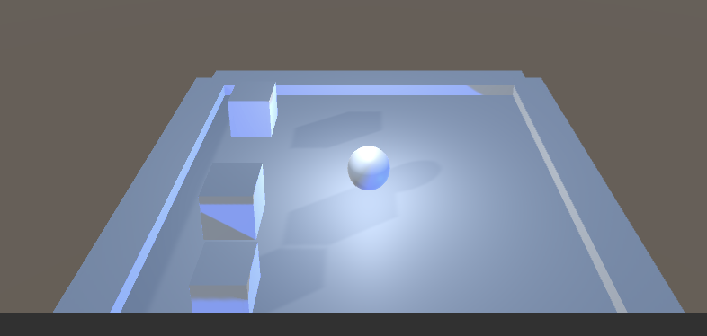
Lab practice
Implement a simple game Roll a Ball with 3D transformation, camera, prefabs and lighting.

